Slide 1
Adversarial Search & Games
Russell &Norvig: Chapter 5
Slides adapted from Prof. Dan Klein, Prof. Pieter Abbeel
ai.berkeley.edu
+
Prof. Bart Selman
Cornell University

Slide 2
Local Search
Tree search keeps unexplored alternatives on the fringe (ensures completeness)
Local search: improve a single option until you can’t make it better
New successor function: local changes
Generally much faster and more memory efficient (but incomplete and suboptimal)
Pretty much unavoidable when the state is “yourself”

Slide 3
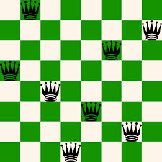
Intro example: N-queens
Problem: Place N queens on an NxN chess board so that no queen attacks another.
Example solution for N = 8.
How hard is it to find
such solutions? What if N gets larger?
Can be formulated as a search problem.
Start with empty board. [Ops? How many?]
Operators: place queen on location (i,j). [N^2. Goal?]
Goal state: N queens on board. No-one attacks another.
N=8, branching 64. Solution at what depth?
N. Search: (N^2)^N Informed search? Ideas for a heuristic?
Issues: (1) We don’t know much about
the goal state. That’s what we are looking for!
(2) Also, we don’t care about path to solution!
What algorithm would you write to solve this?

Slide 4
Local Search: General Principle
Key idea (surprisingly simple):
1) Select (random) initial state (initial guess at solution)
e.g. guess random placement of N queens
2) Make local modification to improve current state
e.g. move queen under attack to “less attacked” square
3) Repeat Step 2 until goal state found (or out of time)
cycle can be done billions of times
Unsolvable if
out of time?
Not necessarily!
Method is incomplete.
Requirements:
generate an initial
(often random; probably-not-optimal or even valid) guess
evaluate quality of guess
move to other state (well-defined neighborhood function)
. . . and do these operations quickly
. . . and don't save paths followed

Slide 5
Local Search
Hill-climbing search or greedy local search
Simulated annealing
Local beam search
Genetic algorithms (related: genetic programming)

Slide 6
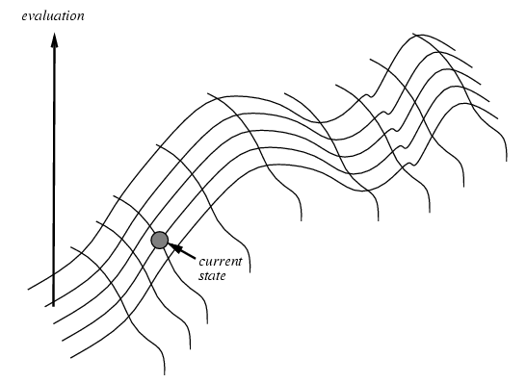
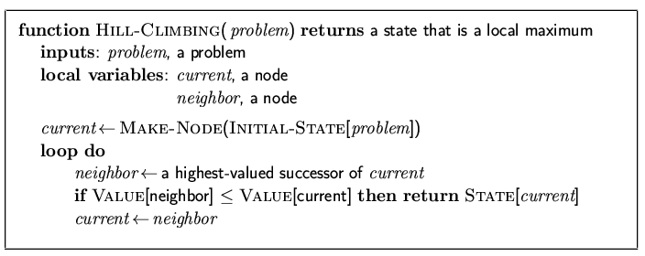
Hill-climbing search
“Like climbing Everest in thick fog with amnesia”
Keep trying to move to a better “neighbor”,
using some quantity to optimize.
Note: (1) “successor” normally called neighbor.
(2) minimization, isomorphic.
(3) stops when no improvement but often better to just
“keep going”, especially if improvement = 0

Slide 7
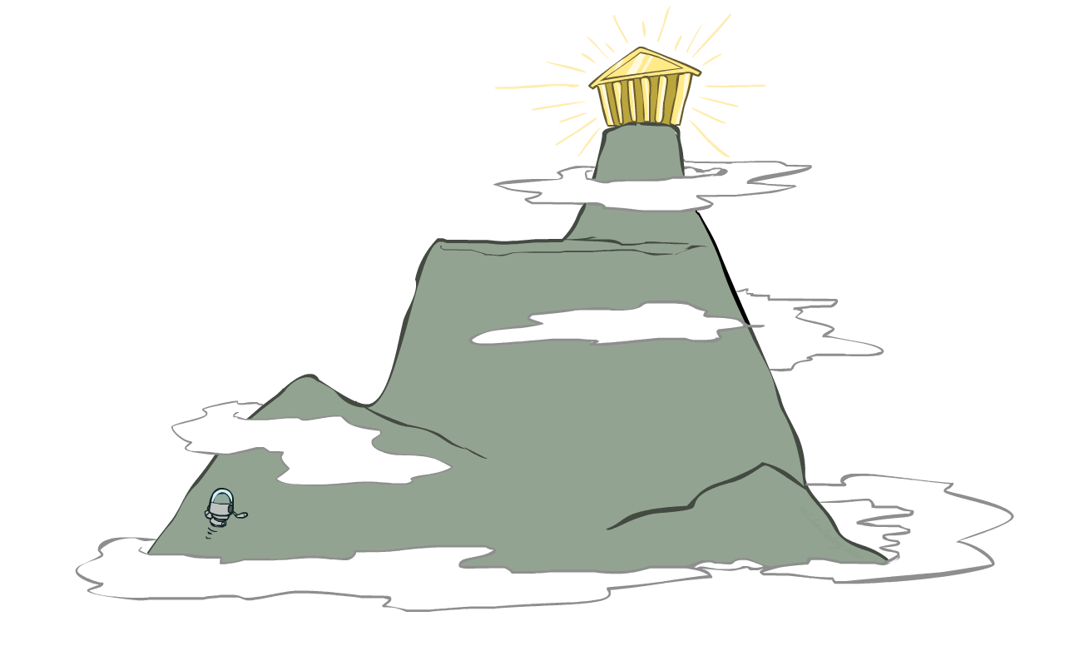
Hill Climbing
Simple, general idea:
Start wherever
Repeat: move to the best neighboring state
If no neighbors better than current, quit

Slide 8
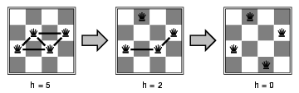
4-Queens
States: 4 queens in 4 columns (256 states)
Neighborhood Operators: move queen in column
Evaluation / Optimization function: h(n) = number of attacks / “conflicts”
Goal test: no attacks, i.e., h(G) = 0
Initial state (guess).
Local search: Because we only consider local changes to the state
at each step. We generally make sure that series of local changes
can reach all possible states.

Slide 9
8-Queens
1
2
2
0
3
2
3
2
2
2
2
2
3
2
Representation: 8 integer variables giving positions of 8 queens in columns
(e.g. <2, 5, 7, 4, 3, 8, 6, 1>)
Section 6.4 R&N (“hill-climbing with min-conflict heuristics”)
Pick initial complete assignment (at random)
Repeat
Pick a conflicted variable var (at random)
Set the new value of var to minimize the number of conflicts
If the new assignment is not conflicting then return it
(Min-conflicts heuristics)
Inspired GSAT and Walksat

Slide 10
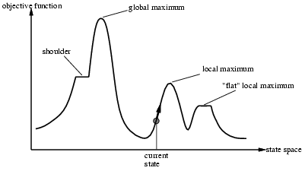
Issues for hill-climbing search
Problem: depending on initial state, can get stuck in local optimum (here maximum)
How to overcome
local optima and plateaus ?
→ Random-restart hill climbing
But, 1D figure is deceptive. True local optima are surprisingly rare in
high-dimensional spaces! There often is an escape to a better state.

Slide 11
Potential Issues with Hill Climbing / Greedy Local Search
Local Optima: No neighbor is better, but not at global optimum.
May have to move away from goal to find (best) solution.
But again, true local optima are rare in many high-dimensional spaces.
Plateaus: All neighbors look the same.
8-puzzle: perhaps no action will change # of tiles out of place.
Soln. just keep moving around! (will often find some improving
move eventually)
Ridges: sequence of local maxima
May not know global optimum: Am I done?

Slide 12
Improvements to Greedy / Hill-climbing Search
Issue:
How to move more quickly to successively better plateaus?
Avoid “getting stuck” / local maxima?
Idea: Introduce “noise:”
downhill (uphill) moves to escape from
plateaus or local maxima (mimima)
E.g., make a move that increases the number of attacking pairs.
Noise strategies:
1. Simulated Annealing
Kirkpatrick et al. 1982; Metropolis et al. 1953

Slide 13
Simulated Annealing
Idea:
Use conventional hill-climbing style techniques, but
occasionally take a step in a direction other than that in which there is improvement (downhill moves; away from solution).
As time passes, the probability that a down-hill step is taken is
gradually reduced and the size of any down-hill step taken is
decreased.
Notes:
Purpose of SA is to avoid local maxima. (Most frequently encountered difficulty with hill climbing.) Idea... [allows downhill steps occasionally].
The undirected steps won't in general reduce the ability of the procedure to find a global maximum (although they might increase the running time). But they may dislodge the problem solver from a foothill, i.e., a local maximum.
Q: Why large steps at first?
A: To avoid local maxima that extend over a wide area of the search space. Like doing a lot of exploring of the whole search space early. Subsequent undirected steps are smaller because we expect to only have to avoid more restricted local maxima.
Name came from an analogy with metal-casting.

Slide 14

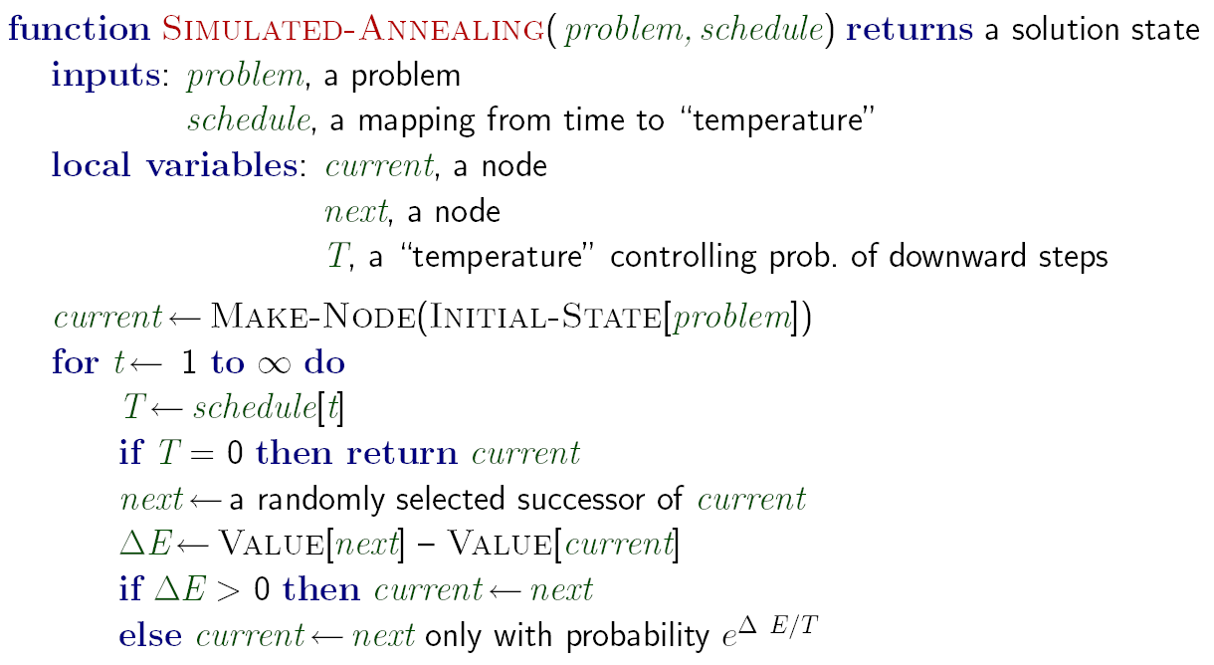
Simulated Annealing
Idea: Escape local maxima by allowing downhill moves
But make them rarer as time goes on

Slide 15
More on Simulated Annealing
Noise model based on statistical mechanics
. . . introduced as analogue to physical process of growing crystals
Convergence:
1. With exponential schedule, will provably converge to global optimum
One can prove: If T decreases slowly enough, then simulated annealing search will find a global optimum with probability approaching
Hundreds of papers / year; original paper (Geman and Geman, T-PAMI 1984) one of most cited papers in CS!
Many applications: VLSI layout, factory scheduling, image restoration, image segmentation, protein folding. . .

Slide 16
Simulated Annealing (SA) --- Foundations
Superficially: SA is local search with some noise added. Noise starts high and is slowly decreased.
True story is much more principled:
SA is a general sampling strategy to sample from a combinatorial space according to a well-defined probability distribution.
Sampling strategy models the way physical systems, such as gases, sample from their statistical equilibrium distributions. Order 10^23 particles. Studied in the field of statistical physics.
We will sketch the core idea.

Slide 17
So, when T gets lowered, the probability distribution starts to “concentrate” on the maximum (and close to maximum) value states.
SA is an example of so-called Markov Chain Monte Carlo or MCMC sampling.
It’s very general technique to sample from complex probability distributions by making local moves only. For optimization, we chose a clever probability distribution that concentrates on the optimum states for low T. (Kirkpatrick et al. 1984)

Slide 18
Some Final Notes on SA
“Claim Equilibrium Distribution” needs proof. Not too difficult but takes a bit of background about Markov Chains. It’s beautiful and useful theory.
How long should we run at each T? Technically, till the process reaches the stationary distribution. Here’s the catch: may take exponential time in the worst case. ☹
How quickly should we “cool down”? Various schedules in literature.
To get (near-)optimum, you generally can run much shorter than needed for full stationary distribution.
Keep track of best solution seen so far.
A few formal convergence rate results exists, including some polytime results (“rapidly mixing Markov chains”).
Many variations on basic SA exist, useful for different applications.

Slide 19
Local Beam Search
Start with k randomly generated states
Keep track of k states rather than just one
At each iteration, all the successors of all k states are generated
If any one is a goal state, stop; else select the k best successors from the complete list and repeat.
Equivalent to k random-restart hill-climbing?
No: Different since information is shared between k search points:
Some search points may contribute none to best successors: one search point may contribute all k successors “Come over here, the grass is greener” (R&N)

Slide 20

Genetic Algorithms
Another class of iterative improvement algorithms
A genetic algorithm maintains a population of candidate solutions for the problem at hand, and makes it evolve by iteratively applying a set of stochastic operators
Inspired by the biological evolution process
Uses concepts of “Natural Selection” and “Genetic Inheritance” (Darwin 1859)
Originally developed by John Holland (1975)

Slide 21
High-level Algorithm
Randomly generate an initial population
Evaluate the fitness of members of population
Select parents based on fitness, and “reproduce” to get the next generation (using “crossover” and mutations)
Replace the old generation with the new generation
Repeat step 2 though 4 till iteration N
Notes:
T is predefined by the user.

Slide 22
Stochastic Operators
Cross-over
decomposes two distinct solutions and then
randomly mixes their parts to form novel solutions
Mutation
randomly perturbs a candidate solution

Slide 23
A successor state is generated by combining two parent states
Start with k randomly generated states (population)
A state is represented as a string over a finite alphabet
(often a string of 0s and 1s)
Evaluation function (fitness function). Higher values for better states.
Produce the next generation of states by selection, crossover, and mutation

Slide 24
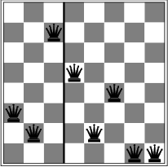
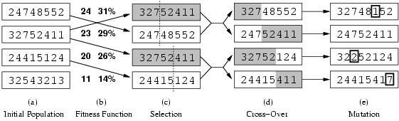
Genetic Algorithms
Operate on state representation.
Fig. 4.6, R&N
production of next generation
random mutation
Fitness function: number of non-attacking pairs of queens (min = 0, max = 8 × 7/2 = 28
→ the higher the better)
24/(24+23+20+11) = 31%
23/(24+23+20+11) = 29% etc
crossover point randomly generated
probability of a given pair selection
proportional to the fitness (b)

Slide 25
Example: N-Queens (Fig. 4.7, R&N)
Why does crossover make sense here?
When wouldn’t it make sense?
What would mutation be?
What would a good fitness function be?

Slide 26
Lots of variants of genetic algorithms with different selection, crossover, and mutation rules.
GAs have a wide application in optimization – e.g., circuit layout and job shop scheduling
Much wirk remains to be done to formally understand GAs and to identify the conditions under which they perform well.

Slide 27
Local Search in Continuous Spaces
Put 3 airports in Romania to minimize the sum of squared distance of each city to its nearest airport
Variables: x₁,y₁,x₂,y₂,x₃,y₃
C_{i} = set of cities nearest to i
Cost f(x₁,y₁,x₂,y₂,x₃,y₃) =
(x₁,y₁)
(x₂,y₂)
(x₃,y₃)

Slide 28
Local Search in Continuous Spaces
Cost f(x₁,y₁,x₂,y₂,x₃,y₃) =
Method 1: discretize, compute empirical gradient f(x₁+dx,y₁,x₂,y₂,x₃,y₃) etc.
Method 2: stochastic descent: generate small random vector dx and accept if f(x+dx) < f(x)
(x₁,y₁)
(x₂,y₂)
(x₃,y₃)

Slide 29
Local Search in Continuous Spaces
Cost f(x₁,y₁,x₂,y₂,x₃,y₃) =
Method 3: take small step along gradient vector
(x₁,y₁)
(x₂,y₂)
(x₃,y₃)

